Slide 1

Lecture 6： Kalman Filter Implementations Localization
Department of Mechanical Engineering and Automation
Dr. Chen Haoyao
hychen5@hitsz.edu.cn

Slide 2
Localization
Chapter 7
“Using sensory information to locate the robot in its environment is the most fundamental problem to providing a mobile robot with autonomous capabilities.” [Cox ’91]
Given
Map of the environment.
Sequence of sensor measurements.
Wanted
Estimate of the robot’s position.

Slide 3
Localization
Chapter 7
“Using sensory information to locate the robot in its environment is the most fundamental problem to providing a mobile robot with autonomous capabilities.” [Cox ’91]
Problem Taxonomy
Local Versus Global Localization
Static Versus Dynamic Environments
Passive Versus Active Approaches
Single-Robot Versus Multi-robot
Local VS Global:
Position tracking
Global localization
Kidnapped robot problem (recovery)

Slide 4
Localization
Chapter 7

Slide 5
Localization
Chapter 7
Position tracking

Slide 6
Localization
Chapter 7
Global localization

Slide 7
Example Study
Landmark-based Localization
Based on Kalman Filter

Slide 8
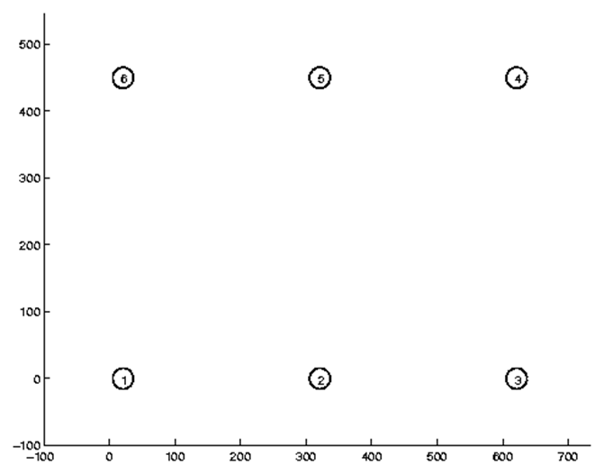
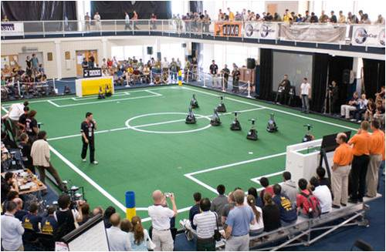
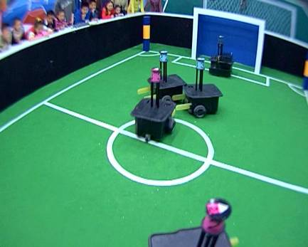
Landmark-based Localization
Chapter 7

Slide 9
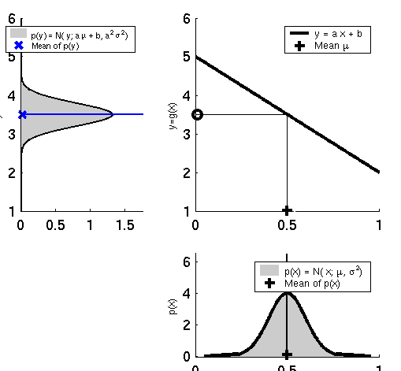
Linearity Assumption Revisited
Chapter 7

Slide 10
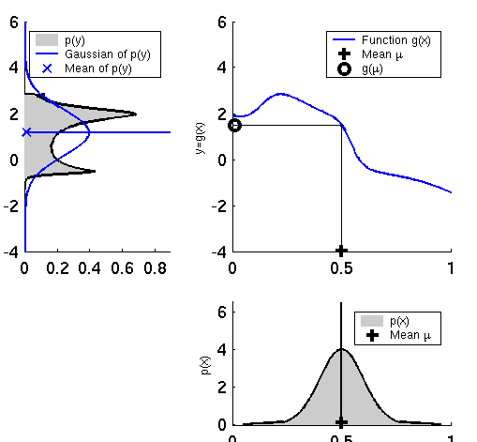
Non-linear Function
Chapter 7

Slide 11
EKF Linearization: First Order Taylor Series Expansion
Chapter 7
Prediction:
Correction:

Slide 12
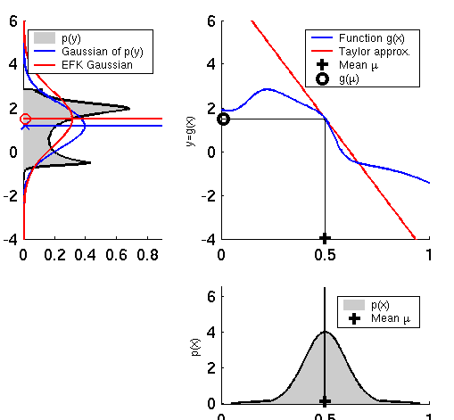
EKF Linearization (1)
Chapter 7

Slide 13
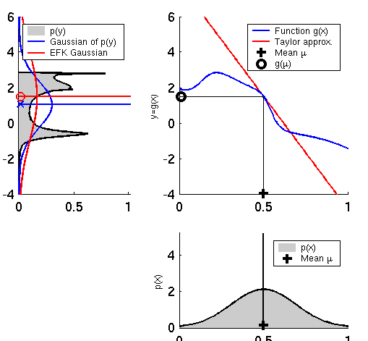
EKF Linearization (2)
Chapter 7

Slide 14
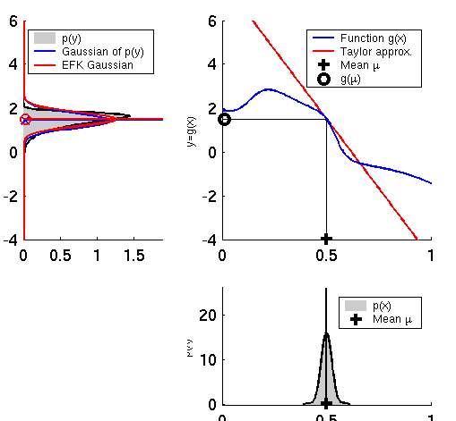
EKF Linearization (3)
Chapter 7

Slide 15
EKF Algorithm
Chapter 7
Extended_Kalman_filter( μ_{t-1}, Σ_{t-1}, u_{t}, z_{t}):
Prediction:
Correction:
Return μ_{t}, Σ_{t}

Slide 16
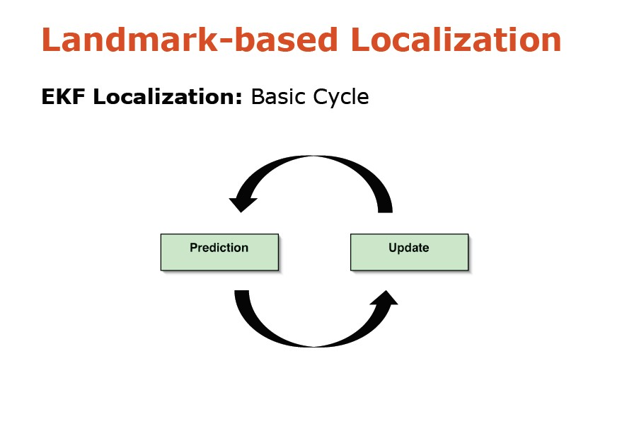
Chapter 7

Slide 17
Chapter 7
EKF_localization ( μ_{t-1}, Σ_{t-1}, u_{t}, z_{t}, m): Prediction:
Jacobian of g w.r.t location
Just for mobile robots, may be different for other robot
Jacobian of g w.r.t control
Motion noise
Predicted mean
Predicted covariance

Slide 18
Chapter 7
EKF_localization ( μ_{t-1}, Σ_{t-1}, u_{t}, z_{t}, m): Correction:
Predicted measurement mean
Jacobian of h w.r.t location
Pred. measurement covariance
Range and bearing model, introduced in Chapter 6
Kalman gain
Updated mean
Updated covariance

Slide 19
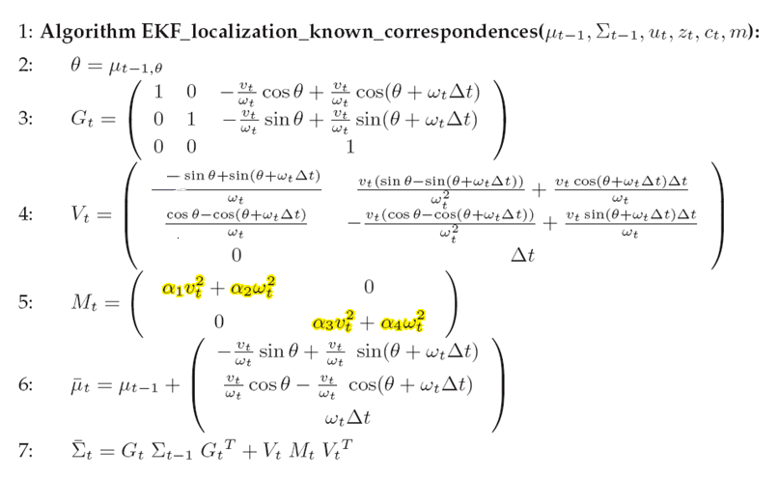
EKF Prediction Step (known correspondences)
Chapter 7
Model example: Velocity Model, introduced in Chapter 5

Slide 20
EKF Correction Step (known correspondences)
Chapter 7

Slide 21
EKF Prediction Step (unknown correspondences)
Chapter 7

Slide 22
EKF Prediction Step (known correspondences)
Chapter 7

Slide 23
EKF Correction Step (unknown correspondences)
Chapter 7

Slide 24
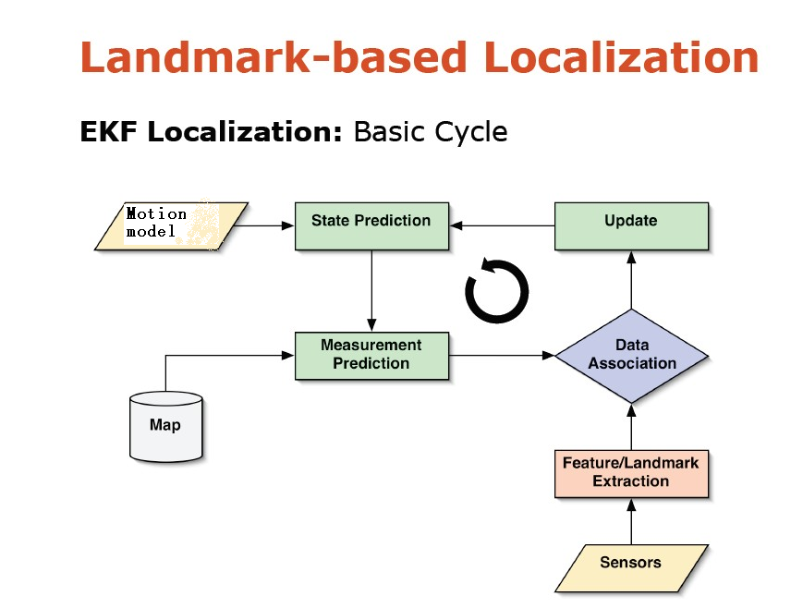
Chapter 7

Slide 25
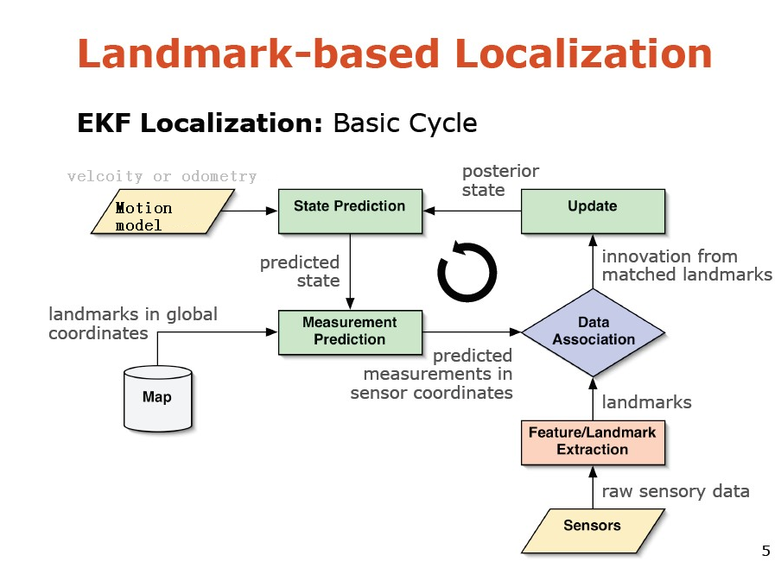
Chapter 7

Slide 26
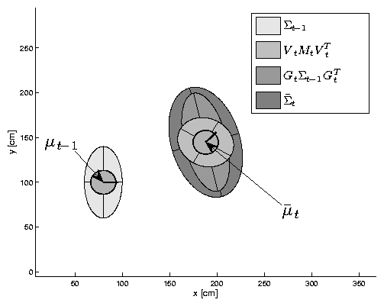

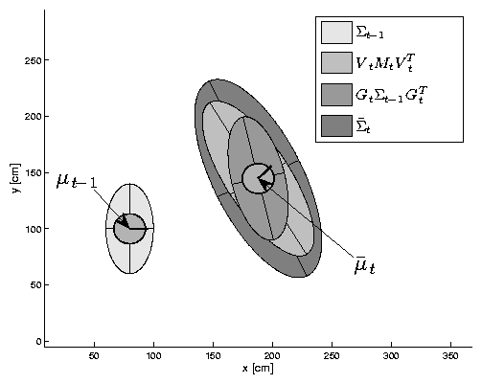


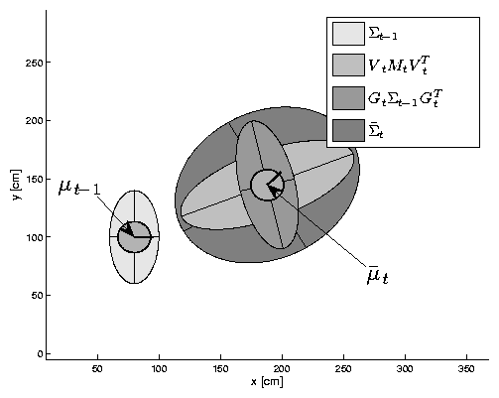
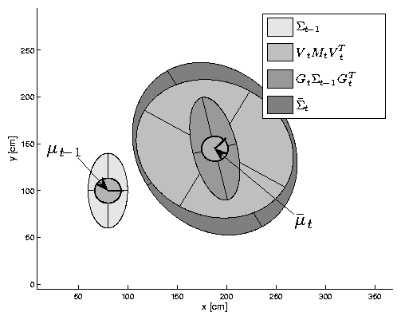
EKF Prediction Step
Chapter 7

Slide 27
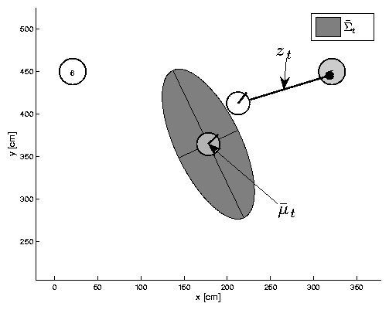
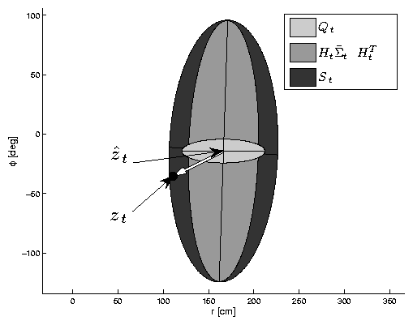




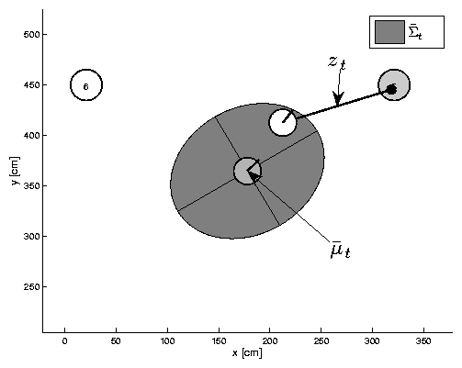
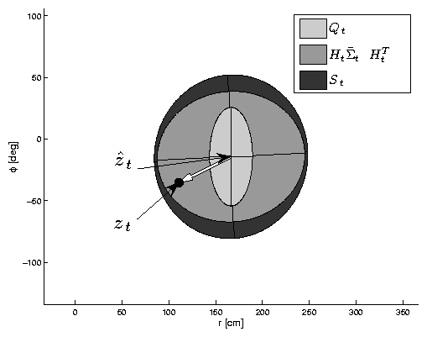
EKF Observation Prediction Step
Chapter 7
True pose
landmark
Innovation
Predicted pose

Slide 28
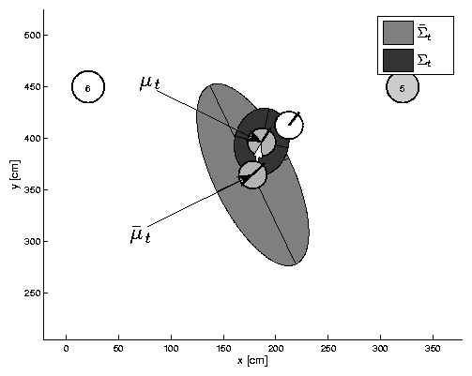
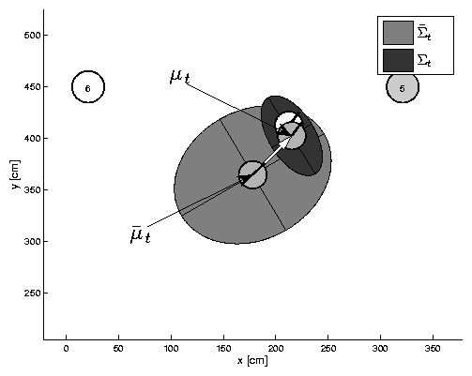
EKF Correction Step
Chapter 7
Estimated pose
True pose
Predicted pose

Slide 29
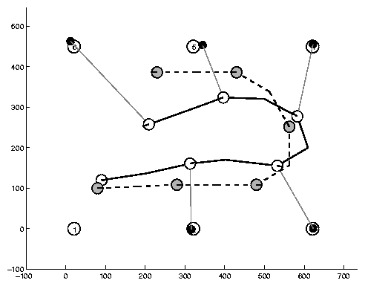
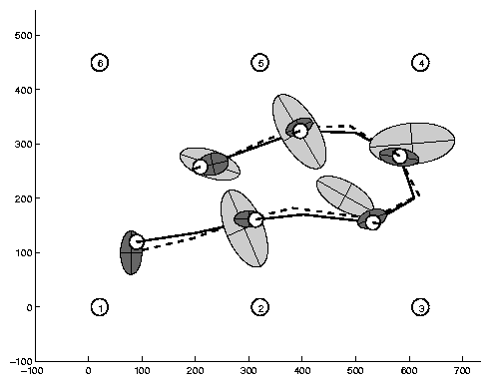
Estimation Sequence (1)
Chapter 7
observation/measurement
Posterior
convariance
Predicted convariance
Landmark/feature

Slide 30
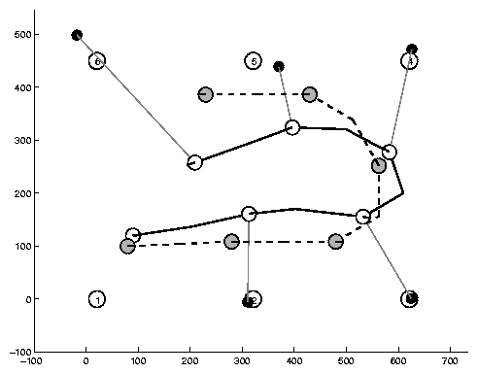
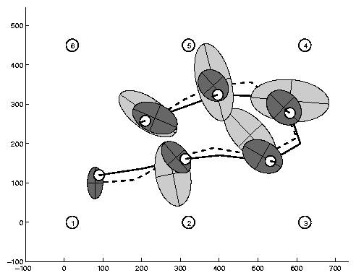
Estimation Sequence (2)
Chapter 7

Slide 31
EKF Summary
Chapter 7
Highly efficient: Polynomial in measurement dimensionality k and state dimensionality n: O(k^{2.376} + n²)
Not optimal!
Can diverge if nonlinearities are large!
Works surprisingly well even when all assumptions are violated!

Slide 32
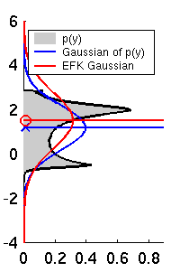
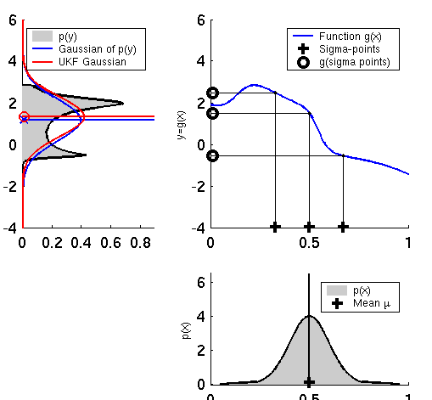
Linearization via Unscented Transform
Chapter 7
EKF
UKF

Slide 33
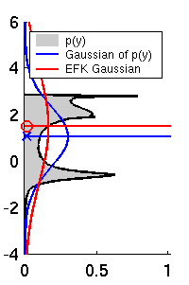
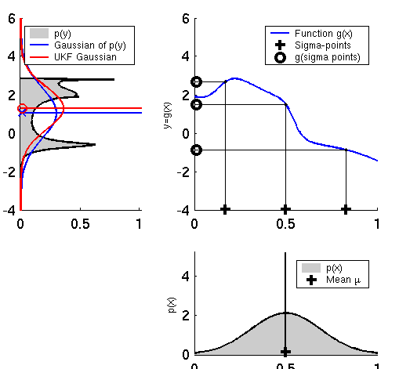
UKF Sigma-Point Estimate (2)
Chapter 7
EKF
UKF

Slide 34
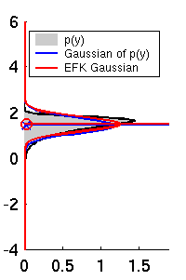
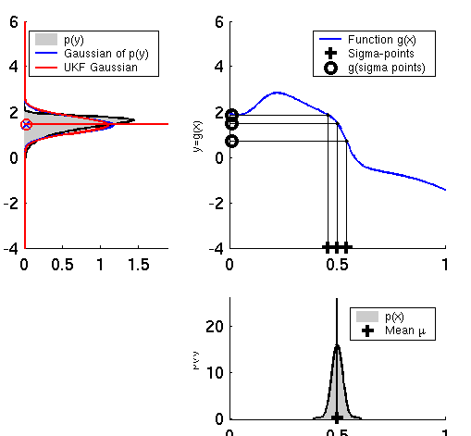
UKF Sigma-Point Estimate (3)
Chapter 7
Sigma-Points
EKF
UKF

Slide 35
Unscented Transform (Chapter 3, pp. 65-71)
Chapter 7
Sigma points
Weights

Slide 36
Propagation of Sigma Points
Each sigma point is propagated through the nonlinear function
and the estimated mean and covariance of y are computed as follows
These estimates of the mean and covariance are accurate to the second order of the Taylor series expansion of for any nonlinear function

Slide 37
Propagation of Sigma Points (cont’d)
Comparison
The EKF only calculates the posterior mean and covariance accurately to the first order with all higher order moments truncated; however, UT calculates the mean and covariance to the second order.
Detailed proof:
Ref: Simon Julier and Jeffrey K. Uhlmann, A General Method for Approximating Nonlinear Transformations of Probability Distributions

Slide 38
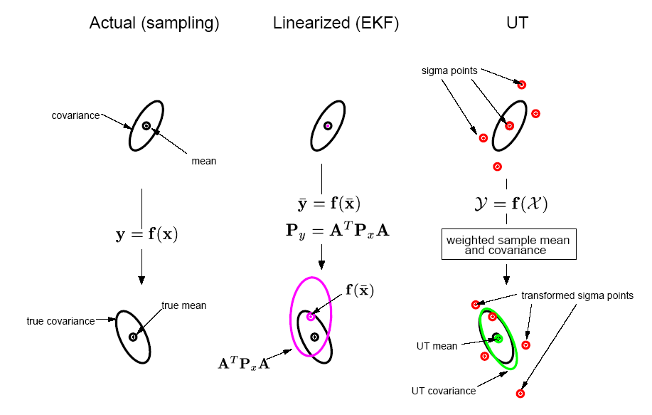
Example
A cloud of 5000 samples drawn from a Gaussian prior is propagated through an arbitrary highly nonlinear function and the true posterior sample mean and covariance are calculated, which can be regarded as a ground truth of the two approaches, EKF and UT.

Slide 39

Chapter 7
UKF_localization ( μ_{t-1}, Σ_{t-1}, u_{t}, z_{t}, m):
Prediction:
Motion noise
Measurement noise
Augmented state mean
Augmented covariance
Sigma points
Prediction of sigma points
Predicted mean
Predicted covariance

Slide 40
Chapter 7
UKF_localization ( μ_{t-1}, Σ_{t-1}, u_{t}, z_{t}, m):
Correction:
Measurement sigma points
Predicted measurement mean
Pred. measurement covariance
Cross-covariance
Kalman gain
Updated mean
Updated covariance

Slide 41
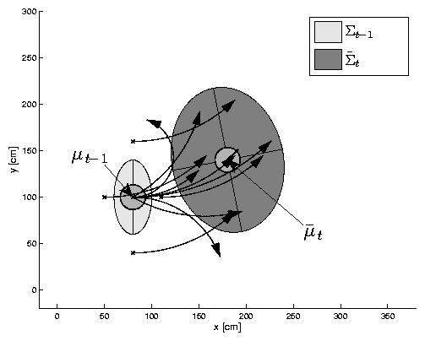
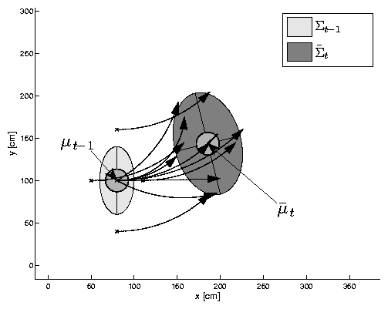
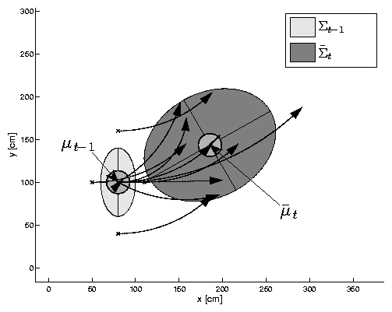
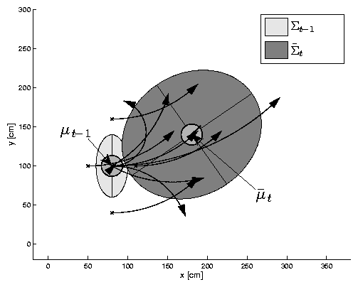
UKF Prediction Step
Chapter 7
Sample mapping

Slide 42
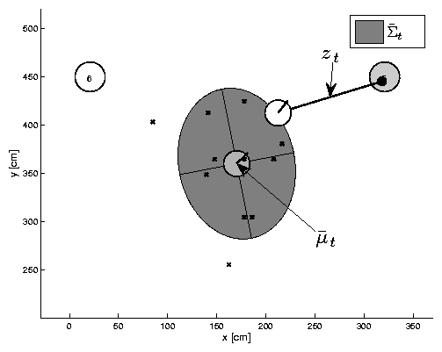
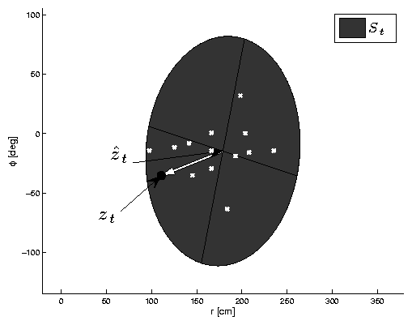

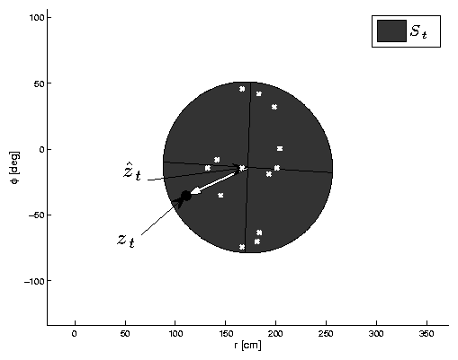
UKF Observation Prediction Step
Chapter 7

Slide 43
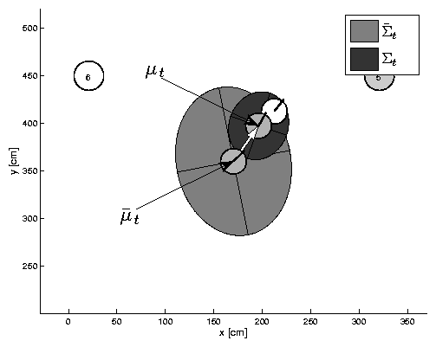

UKF Correction Step
Chapter 7

Slide 44
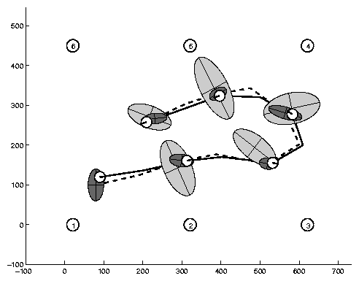
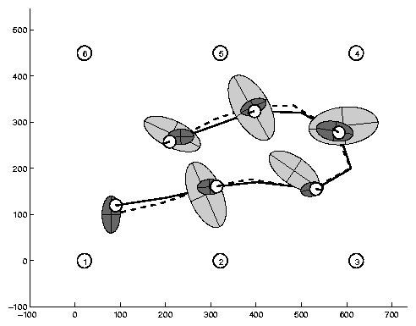
Estimation Sequence
Chapter 7
EKF PF UKF

Slide 45
Estimation Sequence
Chapter 7
EKF UKF

Slide 46
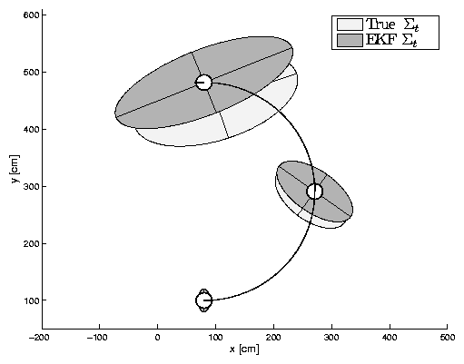
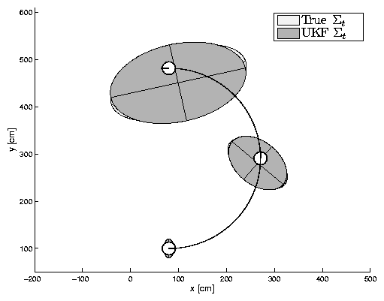
Prediction Quality
Chapter 7
EKF UKF

Slide 47
UKF Summary
Chapter 7
Highly efficient: Same complexity as EKF, with a constant factor slower in typical practical applications
Better linearization than EKF: Accurate in first two terms of Taylor expansion (EKF only first term)
Derivative-free: No Jacobians needed
Still not optimal!

Slide 48
Information Filter (IF)
Information Filter VS Kalman Filter
Linear and Gaussian assumptions
Belief representation:
Canonical and Moment
Information matrix
Information vector
Belief

Slide 49
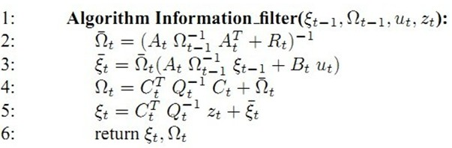
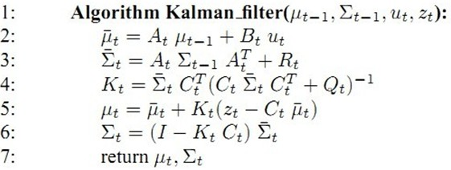
Information Filter (IF)
Prediction
Correction

Slide 50
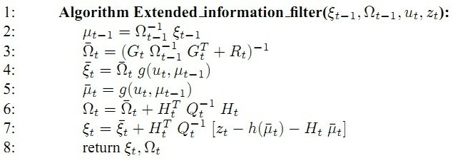
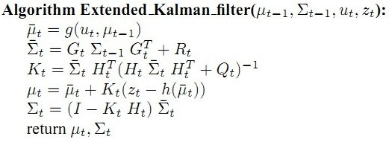
Information Filter (IF)
Two inversion

Slide 51
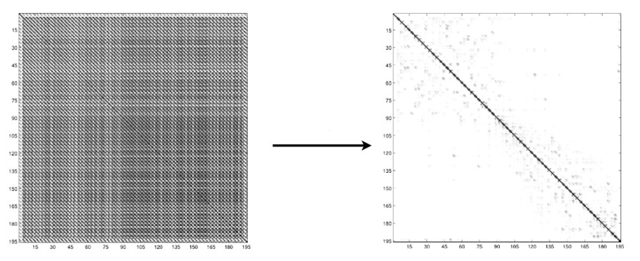
Comparison
 | IF/EIF | KF/EKF
Initial Uncertainty Expression
Information Update | Add: | Multiple:
Multi-robot | Suitable | Not
Computation | O(n^{2.376} + k²) (sparse) | O(k^{2.376} + n²)

Slide 52
Information Filter (IF)
Unscented Transform
UIF

Slide 53
Homework
1. Chapter 7, Page 235，Exercises 1.

